Slide 1
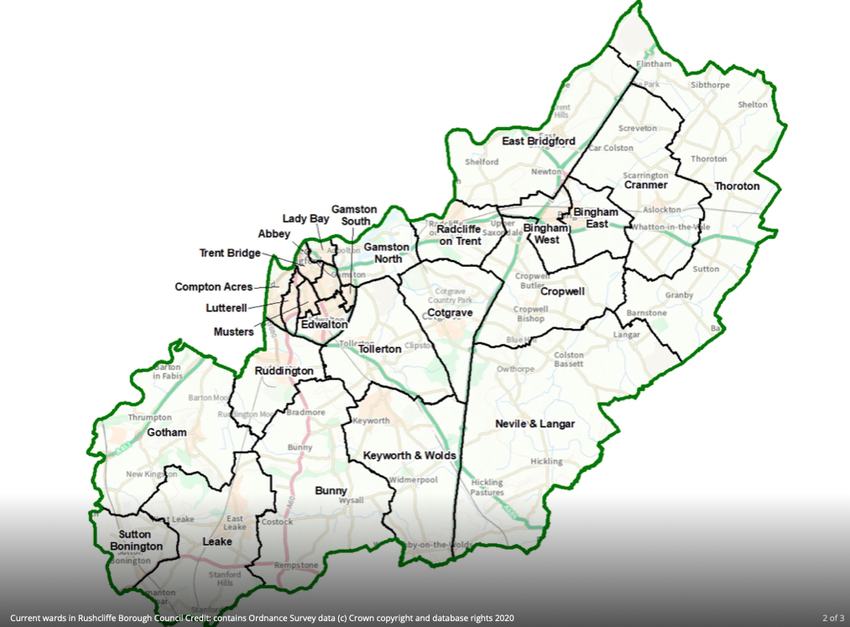
Rushcliffe

Slide 2
The population of Rushcliffe has grown by 10,000 in the last ten years it’s now 126,000

Slide 3
Potential: let’s look at the local again, look at the way we can engage, connect, converse across the borough: see who is there, get a conversation going about Multiply, about Inspire and see how we can let people know we are here for them. Multiply and Inspire are here to help you connect with new opportunities.Well executed this project will help us achieve so many more goals, opportunities and synergies

Slide 4
What is Multiply? It’s a UK wide project to make numbers, maths, calculation and the mystery of mathematics more accessible to more people, more of the time: as Inspire libraries realise: It’s Mathmagics!

Slide 5
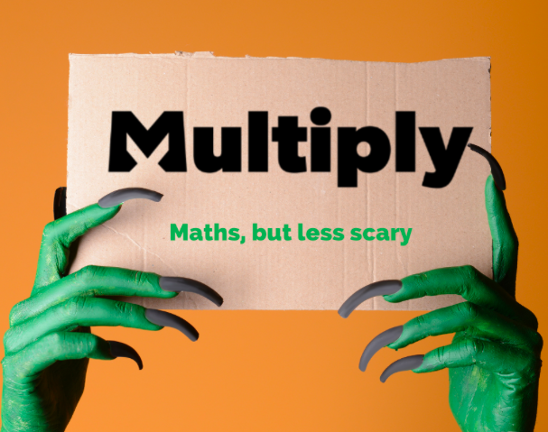
Bringing back your love of learning

Slide 6
This requires work at the neighbourhood level to connect individuals across the social, cultural and economic with Multiply and Inspire using our insights to create participation in Multiply and Inspire learning, sign people up, welcome them into Inspire. Future lifelong learners ambassadors for who we are and what we’re doing.

Slide 7
Rejuvenate relationships across the borough. Connect in the town and village centres talk about Multiply, network it: market days, business, voluntary, charity and support groups across the borough: record and develop contacts, opportunities, referrals with residents, businesses, landlords and agents, heath, education, sports groups, leisure centres.

Slide 8
Create maths conversations, take feedback, grow the Multiply and Inspire brand in our neighbourhood day to day, week to week, month to month, year to year. Use a variety of media to do this

Slide 9
With Multiply we can get a conversation going and offer something immediate: access to maths in venues and online: help people liberate their hopes and aspirations: with the self employed, the apprentices, micro businesses, the mums, the dads, young, middle aged, older, super older. The people who care and the people who feel they don’t care. Carers paid and unpaid have aspirations to contribute, to learn let’s engage them in the neighbourhood conversations about Multiply, Inspire and Lifelong learning.

Slide 10
I think Multiply is an opportunity to encourage people to remember that their lives have meaning: that what they think, feel, aspire to, matters. Multiply is part of a conversation about how we can all do things better and that 100 per cent effort and 100% contribution is an incredible motivator.

Slide 11
The quality of everyone’s future will be based on how we understand and include more people more of the time in the developing conversation about how we can all contribute to improving the way we work, live, make things, do things across the borough. Talking, listening, responding are the IP (!) of Inspirediversity, Inspiredheritage Inspiredconversations about new opportunities, insights that this kind of community development creates.

Slide 12
This feels to me as if I’ll be working in a democracy for a democracy: it’s our potential that we’ve been missing: a potential of connectedness to refamiliarise everyone with themselves and each other

Slide 13
Engage parish, ward and county councillors with Multiply would be a useful way to develop a useful working structure

Slide 14
Making friends with parish, ward and local councillors across the borough so that they can disseminate Multiply throughout their networks in Rushcliffe: councillors speak to people of all ages, backgrounds, genders, ethnicities, sensibilities: this is a great way to rejuvenate the democratic structures around us that are there to support us.

Slide 15
Encourage them to be part of Multiply: let’s get a newsletter/blog/podcast for the borough to take maths thinking everywhere we go: suggest maths surgeries/coffee mornings for parents: Multiply is focus, purpose, challenge, connectivities: living knowledge

Slide 16
Introduce Multiply To Partners as a UK wide Neighbourhood Project, part of a much needed levelling up, part of economic, social, cultural renewal

Slide 17
Partners, Collaborations, Opportunities
The basic assumption and the way I’d approach partners is to build opportunity, ideas, enthusiasm and potential that enables people who participate in Multiply to feel stronger, more capable, full of beans to do more, contribute, participate in Inspire and feel what it’s like to be a citizen in conversation in a culture

Slide 18
Opportunities to connect, encourage sociable public travel, new relationships, groups who want to learn across Rushcliffe an example would be to connect to the work (in social eating) of Dr Marsha Smith: https://opencitydesign.com/2022/07/01/how-do-we-encourage-the-wisdom-experience-ideas-and-energies-of-people-the-conversations-we-all-need-how-about-a-meet-up-with-good-food/

Slide 19
Multiply is an access tool for anyone who wants to progress: inspiring!

