Slide 1

Social Value Presentation
Presented by Kelly Thomas

Slide 2
MTVH’s Approach to Social Value
“Working in partnership with our
contractors and suppliers
to maximise social impact into
the lives of residents and
communities, serving people better
everyday”

Slide 3

New Social Value Policy introduced in July 2020
All new and existing contracts over £100k
Social Value is based on point scoring system that is dependent on contract value
Contractor/ Suppliers can select items from the Social Value menu to create their own Social Value Plan
Introduced Match My Project in Oct 2023
Increased Social Value outcomes by 97.7 % in 22/23

Slide 4
Social Value Now!
New Social Value Policy introduced in July 2020
All new and existing contracts over £100k
Social Value is based on point scoring system that is dependent on contract value
Contractor/ Suppliers can select items from the Social Value menu to create their own Social Value Plan
Introduced Match My Project in Oct 2023
Increased Social Value outcomes by 97.7 % in 22/23

Slide 5



Slide 6

www.mtvh.co.uk

Slide 7
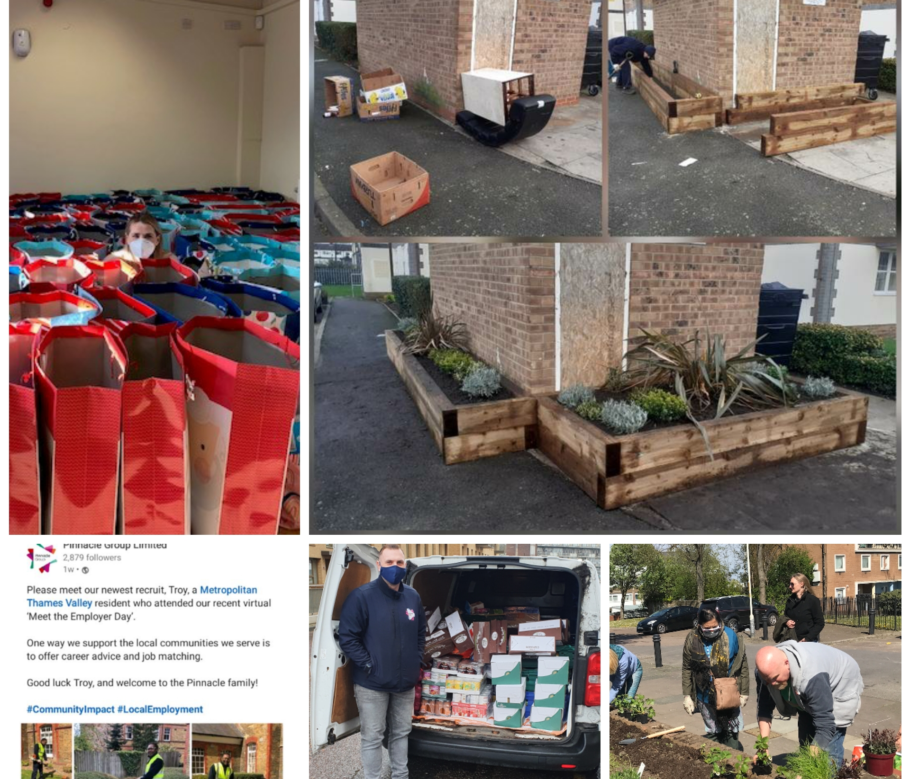
What project have we funded through Social Value ?

